Slide 1
Hash Tables
"hash collision n. [from the techspeak] (var. `hash clash') When used of people, signifies a confusion in associative memory or imagination, especially a persistent one (see thinko).
True story: One of us was once on the phone with a friend about to move out to Berkeley. When asked what he expected Berkeley to be like, the friend replied: 'Well, I have this mental picture of naked women throwing Molotov cocktails, but I think that's just a collision in my hash tables.'"
-The Hacker's Dictionary

Slide 2


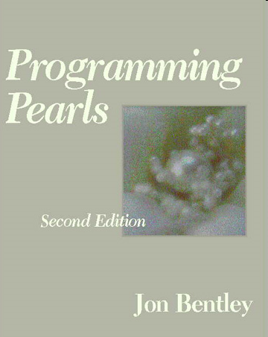
Programming Pearls by Jon Bentley
Jon was senior programmer on a large programming project.
Senior programmer spend a lot of time helping junior programmers.
Junior programmer to Jon: "I need help writing a sorting algorithm."

Slide 3
A Problem
From Programming Pearls (Jon in Italics)
Why do you want to write your own sort at all? Why not use a sort provided by your system? I need the sort in the middle of a large system, and for obscure technical reasons, I can't use the system file-sorting program. What exactly are you sorting? How many records are in the file? What is the format of each record? The file on disk contains at most ten million records; each record is a seven-digit integer. Wait a minute. If the file is that small, why bother going to disk at all? Why not just sort it in main memory? Although the machine has many megabytes of main memory, this function is part of a big system. I expect that I'll have only about a megabyte free at that point. Is there anything else you can tell me about the records? Each one is a seven-digit positive integer with no other associated data, and no integer can appear more than once. The sorted file goes back into the disk.

Slide 4
Questions
What were they sorting?
How do you sort data when it won't all fit into main memory?
Speed of file i/o?

Slide 5
A Solution
/* phase 1: initialize set to empty */
for i = [0, n)
bit[i] = 0
/* phase 2: insert present elements into the set */
for each i in the input file
bit[i] = 1
/* phase 3: write sorted output */
for i = [0, n)
if bit[i] == 1 write i on the output file

Slide 6
Some Structures so Far
ArrayLists
O(1) access
O(N) insertion (average case), better at end
O(N) deletion (average case)
LinkedLists
O(N) access
O(N) insertion (average case), better at front and back
O(N) deletion (average case), better at front and back
Binary Search Trees
O(log N) access if balanced
O(log N) insertion if balanced
O(log N) deletion if balanced

Slide 7
Why are Binary Trees Better?
Divide and Conquer
reducing work by a factor of 2 each time
Can we reduce the work by a bigger factor? 10? 1000?
An ArrayList does this in a way when accessing elements
but must use an integer value
each position holds a single element

Slide 8
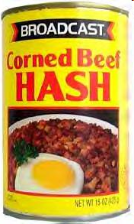
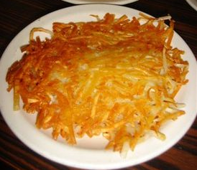
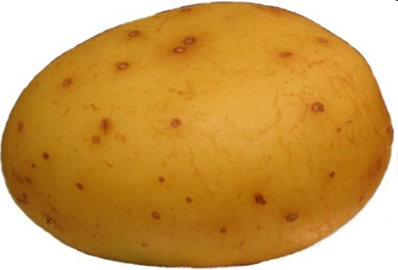
Hash Tables
Hash Tables overcome the problems of ArrayList while maintaining the fast access, insertion, and deletion in terms of N (number of elements already in the structure.)
Hash tables use an array and hash functions to determine the index for each element.

Slide 9
Hash Functions
Hash: "From the French hatcher, which means 'to chop'. "
to hash to mix randomly or shuffle (To cut up, to slash or hack about; to mangle)
Hash Function: Take a large piece of data and reduce it to a smaller piece of data, usually a single integer.
A function or algorithm
The input need not be integers!

Slide 10
Hash Function
5/5/1960
555389085
5125551212
12
”Barrack Obama"
hash function
prez@whitehouse.gov
”Michelle"

Slide 11
Simple Example
Assume we are using names as our key
take 3rd letter of name, take int value of letter (a = 0, b = 1, ...), divide by 6 and take remainder
What does "Bellers" hash to?
L -> 11 -> 11 % 6 = 5

Slide 12
Result of Hash Function
Mike = (10 % 6) = 4
Kelly = (11 % 6) = 5
Olivia = (8 % 6) = 2
Isabelle = (0 % 6) = 0
David = (21 % 6) = 3
Margaret = (17 % 6) = 5 (uh oh)
Wendy = (13 % 6) = 1
This is an imperfect hash function. A perfect hash function yields a one to one mapping from the keys to the hash values.
What is the maximum number of values this function can hash perfectly?

Slide 13
Another Hash Function
Assume the has function for String adds up the Unicode value for each character.
public int hashcode(String s) {
int result = 0;
for(int i = 0; i < s.length(); i++)
result += s.charAt(i);
return result;
}
Hashcode for "DAB" and "BAD"?
301 103
4 4
412 214
5 5
199 199

Slide 14
More on Hash Functions
Normally a two step process
transform the key (which may not be an integer) into an integer value
Map the resulting integer into a valid index for the hash table (where all the elements are stored)
The transformation can use one of four techniques
mapping, folding, shifting, casting

Slide 15
Hashing Techniques
Mapping
As seen in the example
integer values or things that can be easily converted to integer values in key
Folding
partition key into several parts and the integer values for the various parts are combined
the parts may be hashed first
combine using addition, multiplication, shifting, logical exclusive OR

Slide 16
Shifting
More complicated with shifting
int hashVal = 0; int i = str.length() - 1; while(i > 0) { hashVal = (hashVal << 1) + (int) str.charAt(i); i--; }
different answers for "dog" and "god"
Shifting may give a better range of hash values when compared to just folding
Casts
Very simple
essentially casting as part of fold and shift when working with chars.

Slide 17

The Java String class hashCode method
public int hashCode() {
int h = hash;
if (h == 0) {
int off = offset;
char val[] = value;
int len = count;
for (int i = 0; i < len; i++)
h = 31 * h + val[off++];
hash = h;
}
return h;
}

Slide 18
A good hash function
A perfect hash function distributes all keys evenly, and avoids collisions if at all possible.
A good hash function produce a uniform distribution of hash values for the table sizes in use. Why?
Other requirements for different addressing schemes.

Slide 19
Mapping Results
Transform hashed key value into a legal index in the hash table
Hash table normally uses an array as its underlying storage container
Normally get location on table by taking result of hash function, dividing by size of table, and taking remainder
index = key mod n
n is size of hash table
empirical evidence shows a prime number is best
1000 element hash table, make 997 or 1009 elements

Slide 20
Mapping Results
"Isabelle"
230492619
hashCode method
230492619 % 997 = 177
0 1 2 3 .........177............ 996
"Isabelle"

Slide 21
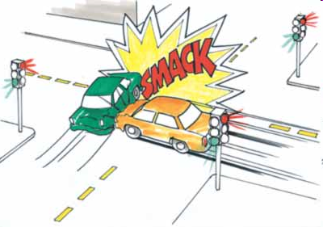
Handling Collisions
What to do when inserting an element and already something present?

Slide 22

Open Address Hashing
Could search forward or backwards for an open space
Linear probing:
move forward 1 spot. Open?, 2 spots, 3 spots
reach the end?
When removing, insert a blank
null if never occupied, blank if once occupied
Quadratic probing
1 spot, 2 spots, 4 spots, 8 spots, 16 spots
Resize when load factor reaches some limit

Slide 23
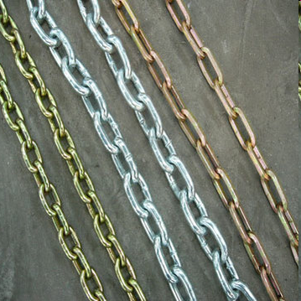
Chaining
Each element of hash table be another data structure
linked list, balanced binary tree
More space, but somewhat easier
everything goes in its spot
Resize at given load factor or when any chain reaches some limit: (relatively small number of items)
What happens when resizing?
Why don't things just collide again?

Slide 24
Hash Tables in Java
hashCode method in Object
hashCode and equals
"If two objects are equal according to the equals (Object) method, then calling the hashCode method on each of the two objects must produce the same integer result. "
if you override equals you need to override hashCode
Overriding one of equals and hashCode, but not the other, can cause logic errors that are difficult to track down.

Slide 25
Hash Tables in Java
HashTable class
HashSet class
implements Set interface with internal storage container that is a HashTable
compare to TreeSet class, internal storage container is a Red Black Tree
HashMap class
implements the Map interface, internal storage container for keys is a hash table

